Slide 1
Intelligent Agents
By Abeeha Sattar

Slide 2

Agents?

Slide 3
Agents and Environments
An agent is anything that can be viewed as perceiving its environment through sensors and acting upon that environment through actuators.

Slide 4
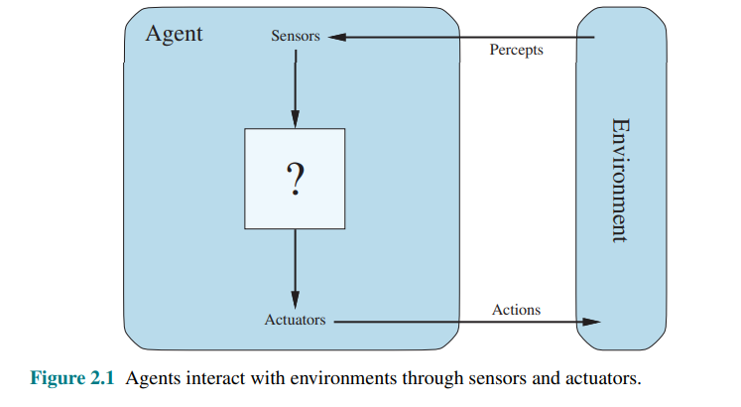
Agents and Environments

Slide 5
Let’s Define these Terms…
Agent
Environment
Sensor
Actuator
Percept
Percept Sequence
Agent Function
Agent Program
Notes:
Percept - the content an agent’s sensors are perceiving
Percept Sequence - he complete history of everything the agent has ever perceived
Agent Function - maps any given percept sequence to an action – It’s mathematical, abstract
Agent Program - the agent function for an artificial agent will be implemented by an agent program

Slide 6
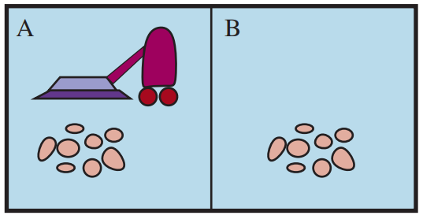
The Vacuum Cleaner World

Slide 7
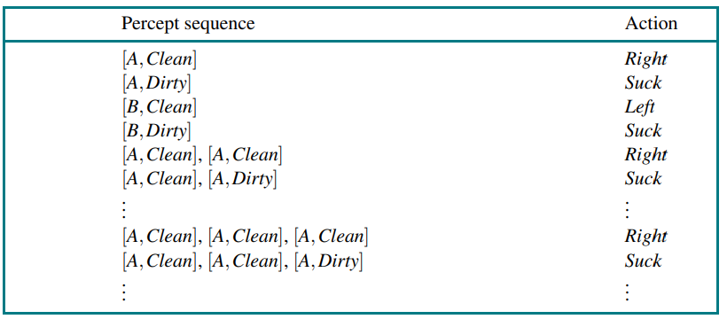
Percept Sequence – Example

Slide 8
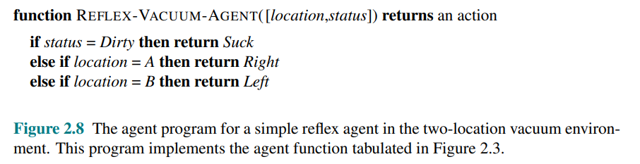
Agent Function

Slide 9
Rational Agents
A rational agent is one that does the right thing.
The right action is the one that will cause the agent to be most successful.
You evaluate the agent based on some performance measure;
Time taken, accuracy, etc.

Slide 10
Rationality
What is rational at any given time depends on four things:
The performance measure that defines the criterion of success.
The agent’s prior knowledge of the environment.
The actions that the agent can perform.
The agent’s percept sequence to date.

Slide 11
Rational Agent – Textbook Definition
For each possible percept sequence, a rational agent should select an action that is expected to maximize its performance measure, given the evidence provided by the percept sequence and whatever built-in knowledge the agent has.

Slide 12
PEAS -- ?
When designing a rational/intelligent agent, we keep in mind PEAS.
Performance Measure
Environment
Actuators
Sensors

Slide 13
PEAS – Automated Taxi Driver
Performance measure: Safe, fast, legal, comfortable trip, maximize profits
Environment: Roads, other traffic, people and objects in/around the street
Actuators: Steering wheel, accelerator, brake, signal, horn
Sensors: Cameras, sonar, speedometer, GPS, odometer, engine sensors, keyboard

Slide 14
PEAS – Medical Diagnostic System
Performance measure: Healthy patient, minimize costs, lawsuits
Environment: Patient, hospital, staff
Actuators: Screen display (questions, tests, diagnoses, treatments, referrals)
Sensors: Keyboard (entry of symptoms, findings, patient's answers)

Slide 15
PEAS – Part Picking Robot
Performance measure: Percentage of parts in correct bins
Environment: Conveyor belt with parts, bins
Actuators: Jointed arm and hand
Sensors: Camera, joint angle sensors

Slide 16
Environment Types (Ch. 2.3.2)
Fully observable vs. partially observable
Single-agent vs. multiagent
  Competitive v/s cooperative
Deterministic vs. nondeterministic(stochastic)
Episodic vs. sequential(non-episodic)
Static vs. dynamic
Discrete vs. continuous
Known vs. unknown

Slide 17
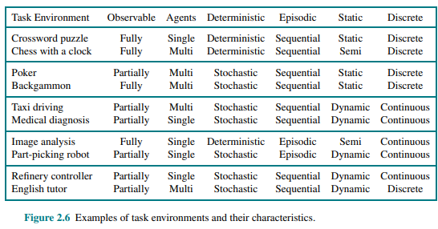
Environment Type

Slide 18
Environment Types
The environment type largely determines the agent design.
The real world is (of course) partially observable, stochastic, sequential, dynamic, continuous, multi-agent.

Slide 19
Agent
Agent = Architecture + Program
Agent program: implements the agent function— Agent program the mapping from percepts to actions.
We assume this program will run on some sort of computing device with physical sensors and actuators—we call this the agent architecture

Slide 20
Agent Types
Agents can be divided in to five (05) basic types according to the degree of perceived intelligence and capacity to change the environment:
Simple reflex agents
Model-based reflex agents
Goal-based agents
Utility-based agents
Learning Agents

Slide 21
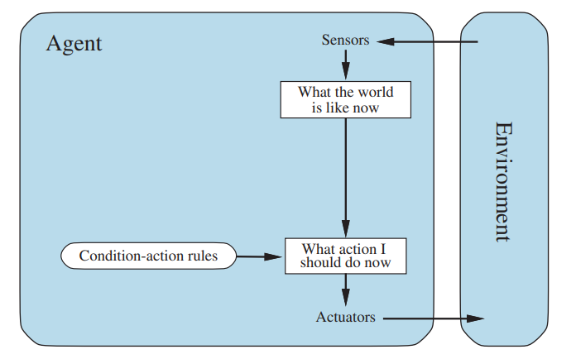
Simple Reflex Agents
The simplest kind of agent
These agents select actions on the basis Simple reflex agent of the current percept, ignoring the rest of the percept history.
Operates in Partially Observable Environments
Infinite loops are unavoidable (unless you randomize actions)

Slide 22
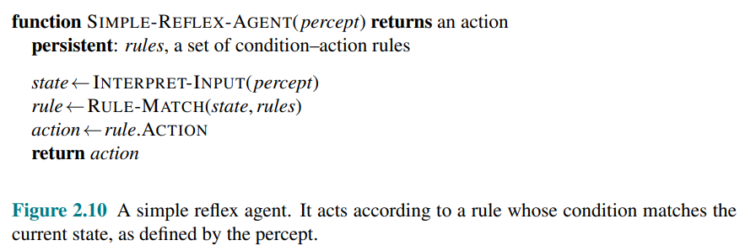
Simple Reflex Agents

Slide 23
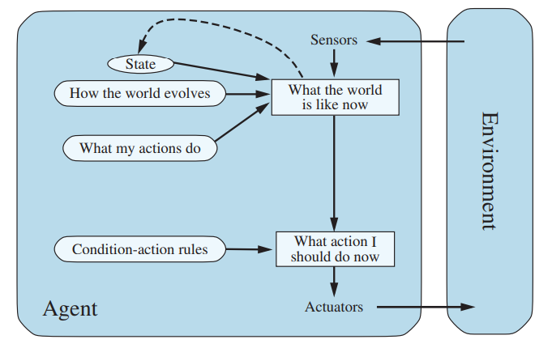
Model-Based Reflex Agents
The agent decides its action(s) based on a predefined set of condition-action rules.
Depending on the state of the world, different actions are appropriate.
State is evaluated in terms of how it changed from the previous state.
Roomba

Slide 24
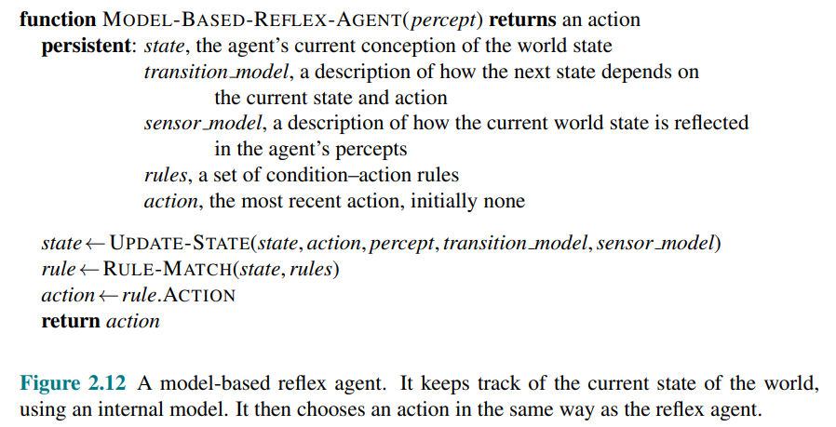
Model-Based Reflex Agents

Slide 25
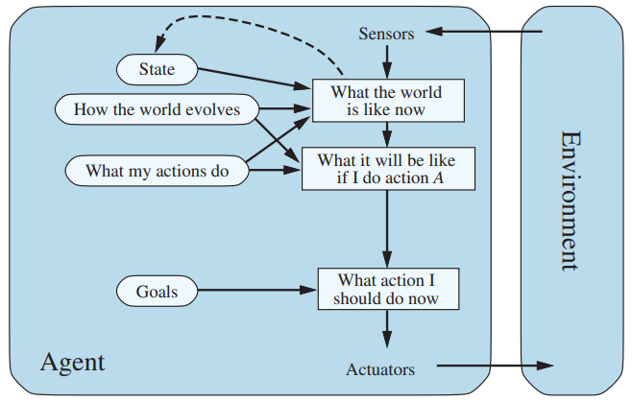
Goal-Based Agents
The agent decides its action(s) based on a known goal.
Contains everything from model-based reflex agents + a goal
Involves consideration of the previous and future states.
Automatic Taxi / GPS System

Slide 26
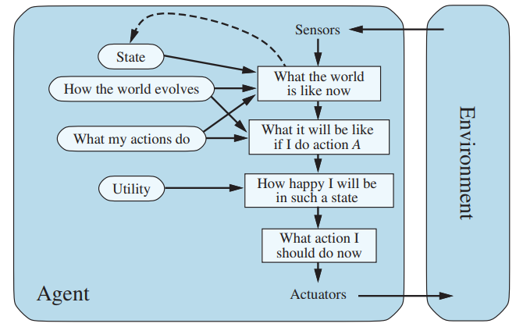
Utility-Based Agents
The agent decides its action(s) based on utilities/ preferences.
Utility function to decide which world state (Optimality) is better for an agent
Google Maps – optimizing distance/time etc. to a destination.

Slide 27
Learning Agents
The agent adapts its action(s) based on feedback (not only sensors).
Learning element - responsible for making improvements from past events.
Performance element - what we have up to now considered to be the entire agent. Takes percepts and then decides on actions.
Critic - gives the learning element feedback on how the performance element is doing and if it needs to be modified.
Problem generator - it suggests actions that lead to new and informative experiences.
e.g. human agent

Slide 28
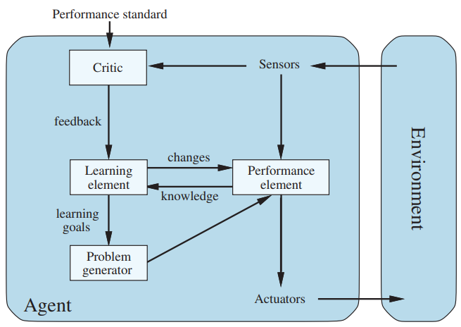
Learning Agents

Slide 29
Fin.
>:3

